Slide 1
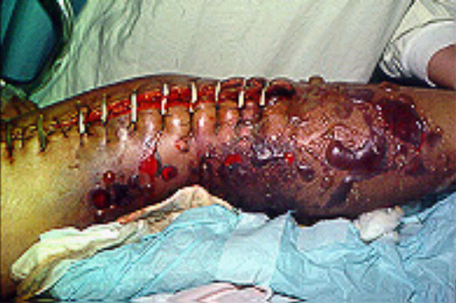
Enteric & enterotoxemic clostridia
The Enteric & enterotoxemic clostridia include:
Cl. Perfringens
Cl. Difficile
Cl. Sordellii
Cl. Colinum
Cl. Spiroforme
cl. pilliform
Clostridium perfringens
Is broadly distributed in the environment & in the intestinal tract of humans & domestic & wild animals. Infecting organism may be originated from exogenous or endogenous ( through contamination of traumatic or surgical wounds or multiplication of organism in the gut under appropriate conditions) sources. It is the most commonly found in human anaerobic infections & the most important cause of clostridial disease in domestic animals. Classification of Cl.perfringens based on the type of toxin produced into type A,B,C,D, & E..

Slide 2
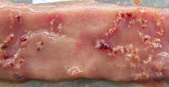
Cl. Perfringens type A (α toxin)
Enteric disease in ruminants remains a diagnostic & management problem. Lamb enterotoxemia (yellow lamb disease), the affected animals exhibit depression, anemia, icterus & hemoglobinuria & dying after a clinical course of 6-12 hrs. Type A associated disease is much more common in beef & dairy calves. Infection maybe originated from ingestion of contaminated colostrum. Gross lesion consist typically of hemorrhagic gastroenteritis. Anaerobic culture usually results in heavy growth of Cl. Perfringens from abomasum & small intestine.
Necrotic enteritis in domestic poultry is usually caused by Cl. Perfringens type A or type C. Mild form of necrotic enteritis result in poor feed, depression, anorexia, & diarrhea.
Neonatal foal may develop hemorrhagic diarrhea as result of Cl. perfringens infection. Lesion include diffuse necrosis of the villi, hyperemia & hemorrhage of intestinal wall.

Slide 3
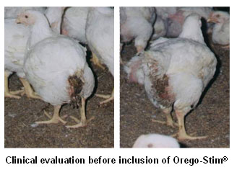
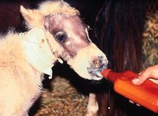
Necrotic enteritis in domestic poultry & Neonatal foal hemorrhagic diarrhea

Slide 4
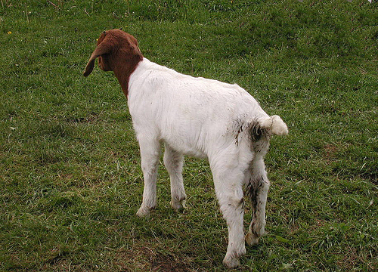
Cl. Perfringens type B β toxin
Lamb dysentery typically develops after infection of neonates by the dam or from the environment. Multiplication of type B in the gut results in enterotoxemia, accompanied by extensive hemorrhage & ulceration of the small intestine. Death is often sudden or may preceded by poor feeding, abdominal pain, bloody diarrhea & coma. The fatality rate may reach 100%.
Type B may also associated with hemorrhagic enteritis in goats, calves, & foals.

Slide 5
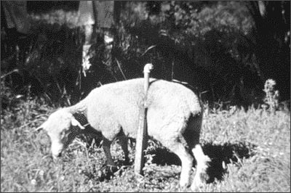
Cl. Perfringens type C
Newborn animals are typically most susceptible to infection by Cl. Perfringens type C, because of ready colonization of the gut in the absence of established normal intestinal flora. Alteration of intestinal flora by sudden dietary change may be a risk factor. Intestinal lesions are usually extensive & severe, & death occurs due to toxemia.
Infection of neonatal calves, lambs & goats with type C causes hemorrhagic necrotic enteritis & enterotoxemia accompanied by nervous signs. Damage to the intestinal mucosa often by poor quality food precede multiplication of type C in abomasum & small intestine. Mucosal necrosis & toxemia result usually without dysentery or diarrhea.
Cl. Perfringens type C is also a cause of foal disease characterized by hemorrhagic diarrhea & dehydration.

Slide 6
Cl. Perfringens type D & E
Type D causes enterotoxemia & sudden death in sheep of all ages except neonates. It is common in suckling lambs 3-10 weeks old. Disease often follow upset of in the gut flora. Rapid multiplication of the organism & production of έ- toxin are favored by excess dietary starch in the small intestine. The effect of έ- toxin on the CNS result in sudden death.
Enterotoxemia in sucking calves is similar to disease in sheep.
Type E Cl.perfringens has been associated with enterotoxemia in lambs, calves & rabbits. Strains of type E are quite common in certain areas, accounting for 3-5% of enteritis in domestic animals, & 50% of hemorrhagic enteritis in calves

Slide 7
Pathogenesis
More than 15 exotoxin of Cl. perfringens have been described. α-toxin is a multifunftional phospholipase produced by all animal isolates. Hydrolysis of cell membrane phospholipid by the α- toxin causes lysis and other effects resulting in hemolysis, necrosis and lethality.
Β- toxin is responsible for mucosal necrosis & CNS signs. Widespread, progressive mucosal necrosis follow by bacterial invasion, multiplication and toxin production & epithelial cell damage & desquamation.
Ε- protopxin is converted to the grater than 1000 folds more toxic E toxin. High concentration of the toxin increases the permeability, with subsequent absorption into circulation. Foci of liquefative necrosis, perivascular edema & hemorrhage occur in CNS, especially in the meninges.

Slide 8
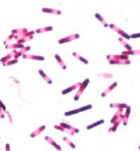
Cl. difficile
Pseudomembranous colitis in humans follows overgrowth of the large intestine by Cl. difficile, usually after bowel flora are upset by antimicrobial therapy or other circumstances.
Cl.difficile induced disease also occurs in a variety of domestic & wild animals including adult horses, foals & swine. Occurrence of Cl.difficile induced disease (CDAD) without prior antimicrobial therapy suggest that antibiotic depression of normal flora is not the only circumstances that allows establishment of Cl. difficile in the bowel.
In horses, the organism is important as a cause of both diarrhea & fatal necrotizing enterocolitis, affected foals are usually neonates & typically display severe hemorrhagic necrotizing enterocolitis, with colic, weakness, profuse watery diarrhea & dehydration. Onset of clinical signs is usually followed by death in 24 hrs.
Virulence attribute may include pilli, capsule, & degradative enzymes, but production of toxins is essential. Toxin A is an enterotoxin, causes fluid accumulation in the gut. Toxin B, a cytotoxin.

Slide 9
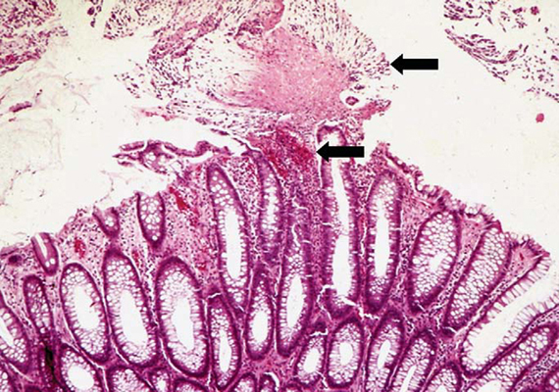
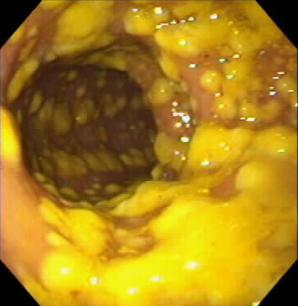
Necrotizing colitis & pseudomembranous colitis

Slide 10
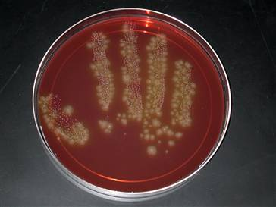
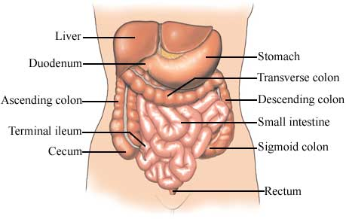
Cl.difficile

Slide 11
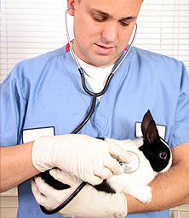
Cl. Sordellii & Cl. piliform
Cl. Sordellii is a common inhabitant of soil & of the intestine of domestic animals. Isolates have been obtained from myositis, liver disease, & sudden death in cattle, sheep, & horses.
Two toxins one hemolytic and one lethal are antigenically similar to Cl. difficile toxin A & B respectively.
Cl. Piliform is the aetiological agent of Tyzzer’s disease, which is typically characterized by severe diarrhea & high mortality. It occurs epizootically in many laboratory and domestic animals. The disease in foals usually occurs before 5 weeks of age. Immunodeficiency may play a role in susceptibility. The clinicopathological abnormalities include leukopenia, metabolic acidosis & hypoglycemia.
In dogs, the infection is typically seen in very young pups with widely disseminated lesions including hepatitis,myocarditis & enterocolitis.

Slide 12
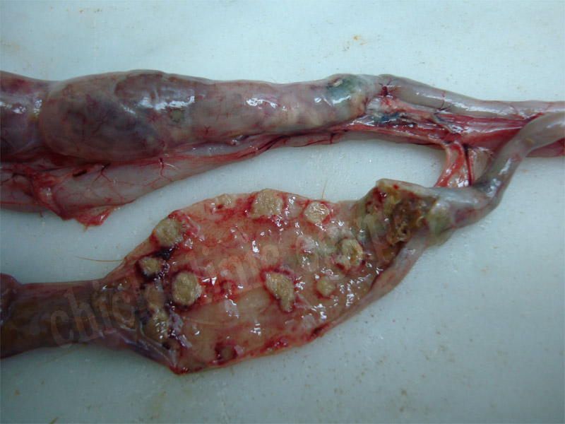
Cl. Spiroforme & Cl. colinum
Cl. Spiroforme causes enterotoxemia of rabbits & other laboratory rodents. It is apparently not found in the rabbit bowel, but it is acquired from the environment. Poor hygiene & diet have a prominent influence on the development of the disease. Weaning or antibiotics treatment disrupt cecal flora providing conditions under which diarrhea develop.
Cl. Colinum causes ulcerative enteritis of chickens & other wild & domestic fowl including turkeys. The condition is characterized by sudden onset and rapidly increasing mortality in a flock. Birds younger than 3 months of age are most commonly affected. The disease follow rapid & fatal clinical course. After establishing in the intestine causes duodenal hemorrhagic enteritis, cecal necrosis & ulceration, bowel perforation may occurs followed by peritonitis. The average mortality in chickens is 10-30%, but may reach 100%.

